Slide 1
Luma Learning Lesson #3:
The Interaction of Electronic Logging Devices (ELDs) & The Short-haul 100 Air-mile Radius Exception

Slide 2
Short-Haul Exception:
CDL drivers operating within 100 air miles of their normal work location and finishing their work day at their normal work location within 12 consecutive hours do not have to prepare a daily record of duty status of their activities.

Slide 3
How many times may a driver operate outside of the 100 air-mile radius exception before that driver is required to use an ELD?

Slide 4
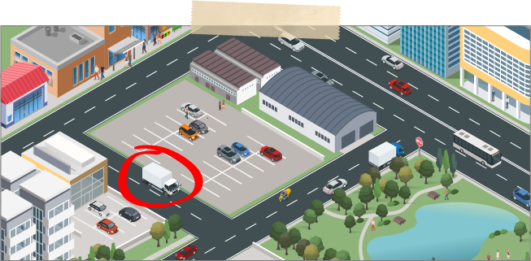
FMCSA decided the ELD rule should allow a 100 air-mile radius driver to operate outside the short-haul exception for not more 8 days within any 30-day period, and still be exempt from the use of an ELD.

Slide 5
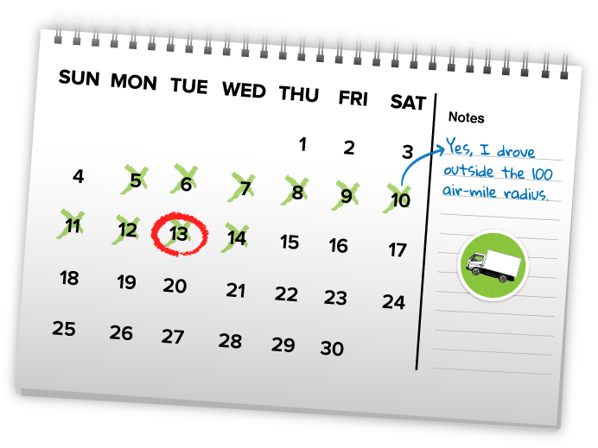
Short-Haul Exception:
This means that, under the ELD rules, on the 9th day in any 30-day period, the typical ‘100 air-mile radius short-haul driver’ is ineligible for the exception and the driver must log the 9th day using an ELD.

Slide 6
If a driver operates outside the 100 air-mile radius exception for 9 or more days within any 30-day period, how long must this short haul driver use an ELD when operating his/her truck in the future. Forever? For a year? For a month? Until the cows come home?

Slide 7
Short-Haul Exception:
As soon as the driver is back within the “not more than 8 days within any 30-day period” portion of the rule, he/she can return to using a paper log on the days when he/she exceeds the 100 air-miles or the 12 consecutive hours restrictions.

