Slide 1

Luma Learning Lesson #20:
Define Personal Productivity

Slide 2
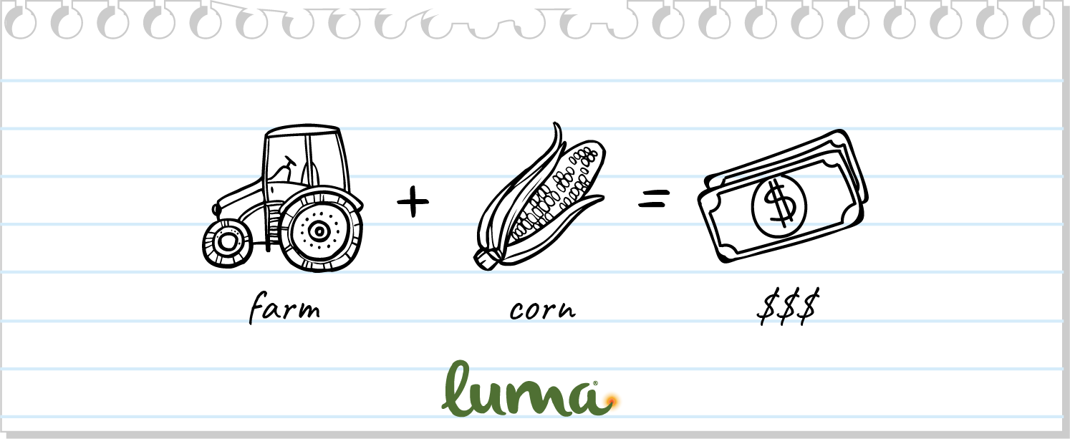

Slide 3
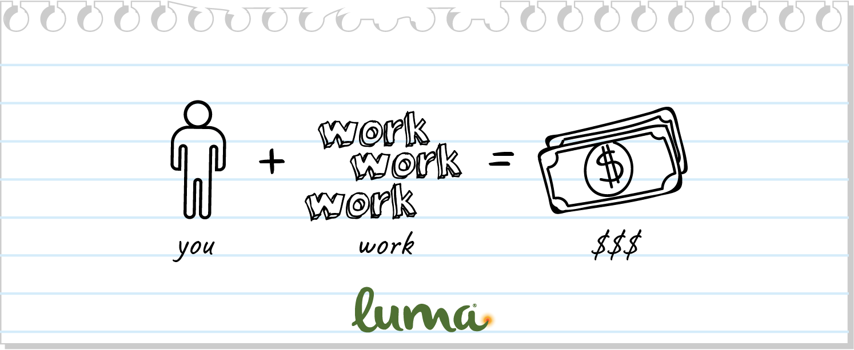

Slide 4
